Slide 1
Employee Data Analysis using Excel
STUDENT NAME: ANURAGHA.R
REGISTER NO :312211015
DEPARTMENT :BACHELOR OF COMMERCE(GENERAL)
COLLEGE : DR.M.G.R. JANAKI COLLEGE OF ARTS AND
SCIENCE FOR WOMEN

Slide 2

PROJECT TITLE
Employee Performance Analysis using Excel

Slide 3


AGENDA
Problem Statement
Project Overview
End Users
Our Solution and Proposition
Dataset Description
Modelling Approach
Results and Discussion
Conclusion
3/21/2024 Annual Review

Slide 4

PROBLEM STATEMENT
Employee performance analysis is done to:
Identify Strengths and Weaknesses: To recognize high performers and areas needing improvement.
Guide Development: To inform training and development plans. Inform Decisions: To make decisions about promotions, raises, and role changes. Enhance Productivity: To improve overall team and organizational efficiency. Set Goals: To establish clear performance goals and expectations.

Slide 5

PROJECT OVERVIEW This project is all about finding the employee performance with the given data set. Employee Performance analysis is crucial for improving project outcomes, optimizing resource use, and enhancing organizational capabilities. This operation is done by using various techniques in MS Excel. It summarizes the performance of each employee department wise. It also depicts the efficient department through visual representation of the computed data.

Slide 6


WHO ARE THE END USERS?
The End users of Employee Performance analysis typically include:
Managers
Human Reources (HR) Professionals
Executives and Senior Leadership
Employees
5.Team Leaders
6.Training and Development Specialists

Slide 7

OUR SOLUTION AND ITS VALUE PROPOSITION
Techniques used:
Conditional formatting- Conditional formating is used to interpret the employee performance level
Pivot table- A pivot table is used for data Organization,data summarization,Dynamic analysis,efficient filtering and sorting and for comparison.
Formula used:=IFS(J2>=5,”VERY HIGH”,J2>=4,”HIGH”,J2>=3,"MED",TRUE,”LOW”)
Graph: A bar graph is inserted using the pivot table.

Slide 8

Dataset Description
This Employee data set was downloaded from google for performing employee performance analysis in Excel.
There are 11 features used in this Employee Performance Analysis. They are:
EMPLOYEE ID
NAME
DEPARTMNET
ROLE
AGE
GENDER
EXPERIENCE
ATTENDANCE
PROJECT COMPLETED
RATING
PERFORMANCE LEVEL

Slide 9

THE "WOW" IN OUR SOLUTION
Formula used:=IFS(J2>=5,”VERY HIGH”,J2>=4,”HIGH”,J2>=3,”MED”,TRUE,”LOW”)
3/21/2024 Annual Review
9

Slide 10
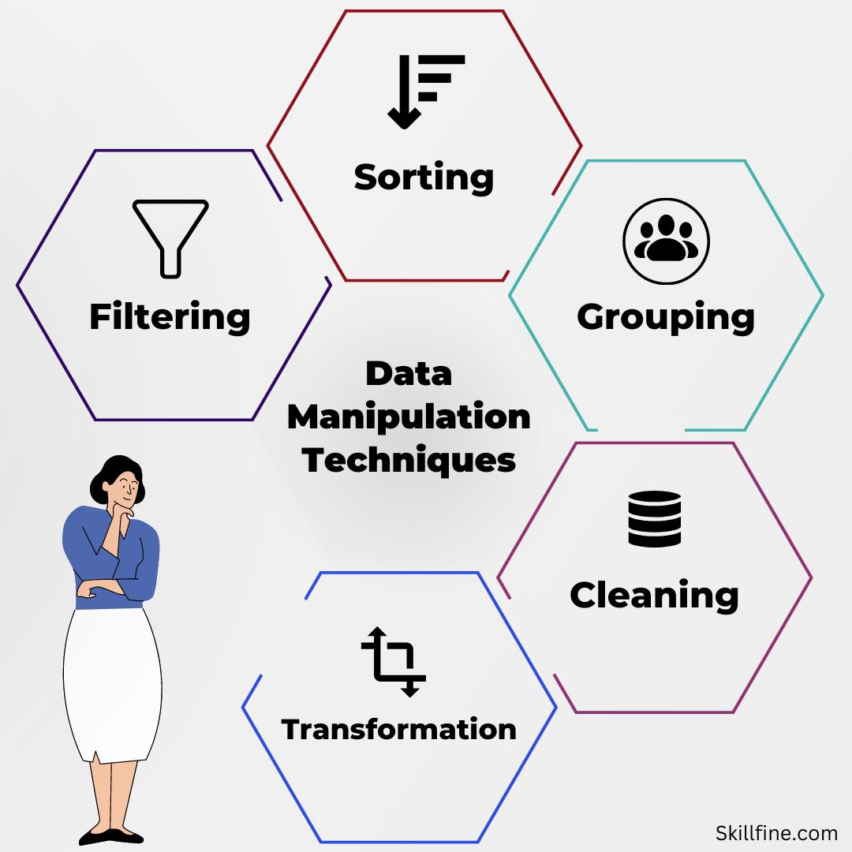
MODELLING
Data Collection: Gather all relevant employee data, such as names, job titles, departments, salaries, hire dates, performance metrics, etc.
Data Organization:
Tabulate Data: Ensure the data is organized into columns and rows with clear headers.
Clean Data: Remove any duplicates, correct errors, and handle missing values.
Descriptive Statistics:Calculate Averages: Compute average salary, average tenure, etc.Determine Distributions: Analyze the distribution of employees by department, job title, performance ratings, etc.
Performance Analysis:Performance Metrics: Analyze performance scores or ratings.
Creating a PivotTable after organising the data and performance level.
Visualization:
Charts and Graphs: Create visual representations such as pie charts, bar graphs, and line graphs to illustrate key findings.
10

Slide 11
RESULTS
11

Slide 12
conclusion
With the help of the visual representation and pivot table we could come to a conclusion by finding:
Most of the employees performance level are Medium.
The sales department has the highest number of employees with medium performance level.
The graph shows that the sales department are efficient in their working and IT and Marketing department are equally doing good.
This distribution provides a comprehensive overview of how employees are performing across different levels, highlighting areas of strength and areas needing improvement within the organization.

